Slide 1
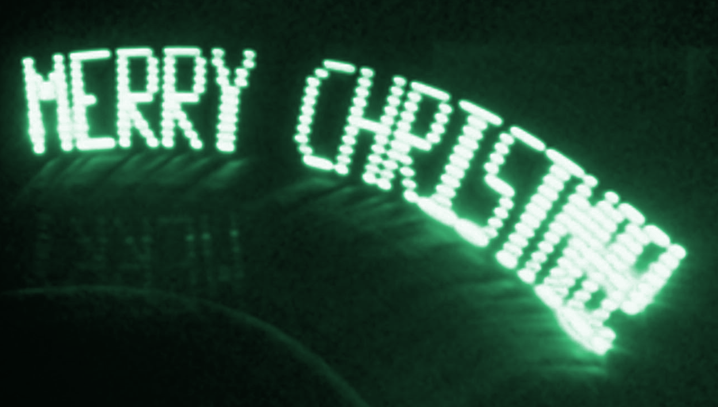
Persistence of Vision Wands
Aron, Ben, Collin, Dan [ABCD]
Operation Harry Potter
Notes:
Dan; Presentation time goal: 10-15 minutes

Slide 2
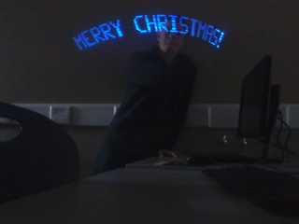
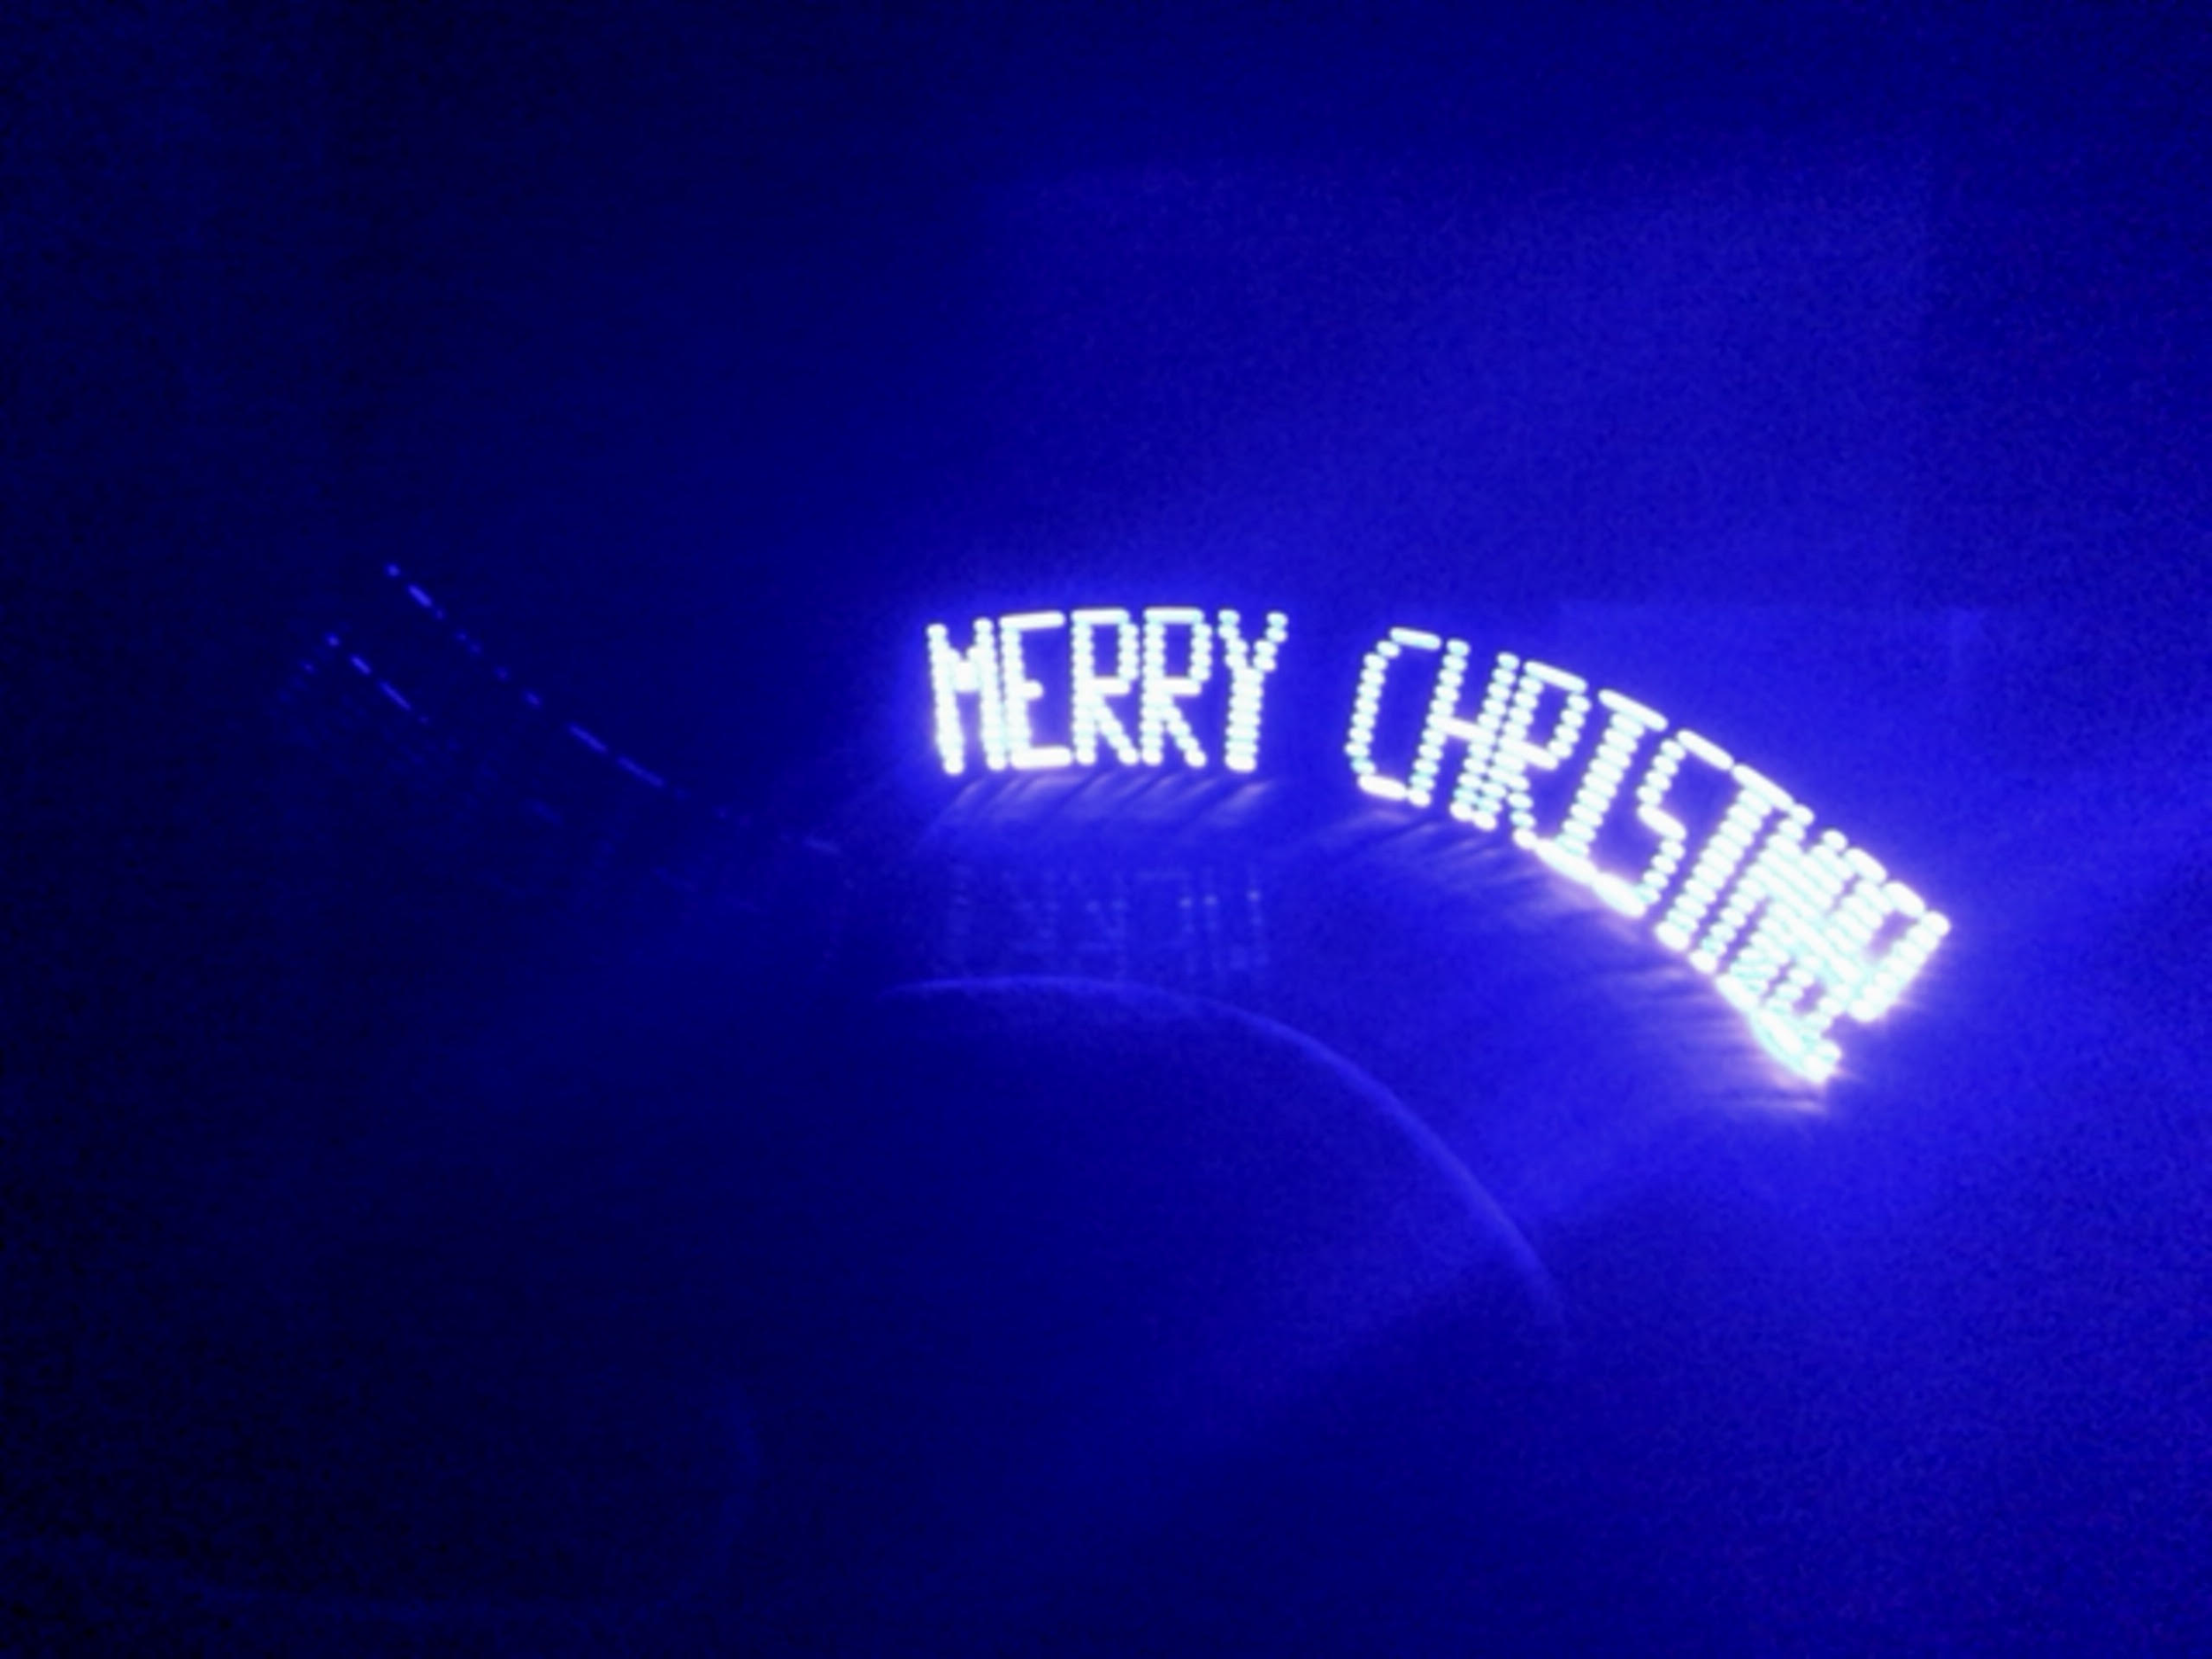
Introduction
Notes:
Dan; define persistence of vision

Slide 3
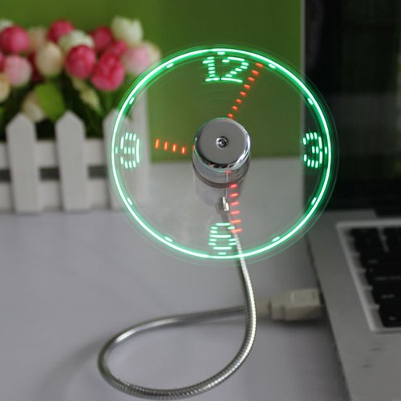
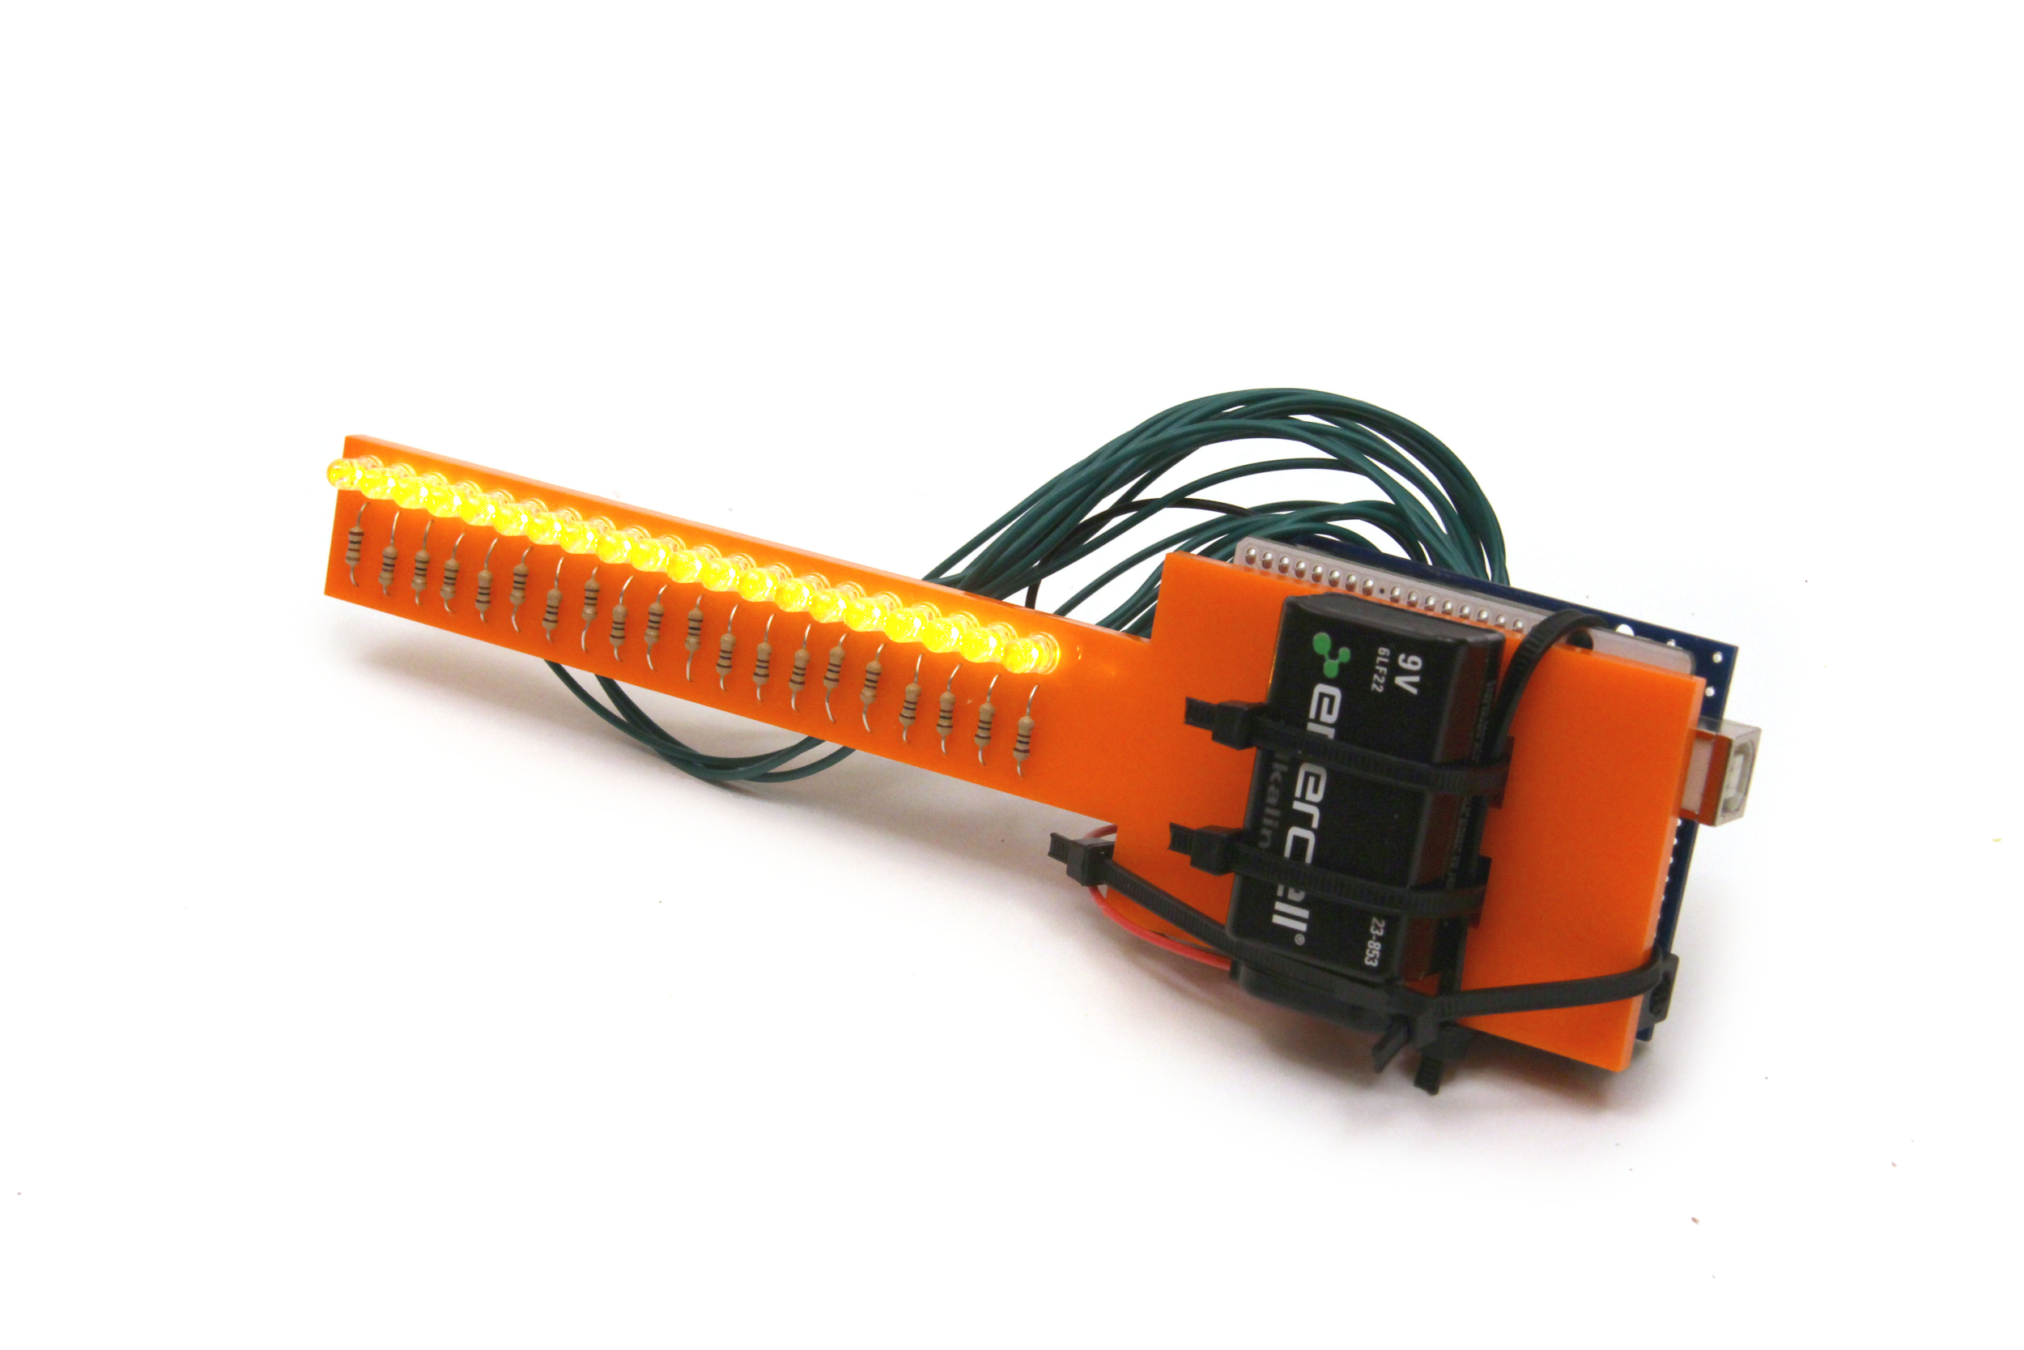
Market Analysis
LED fans
Programmed vs personalizable messages
B2ocled’s LED clock fan for $8.99
Ghassaei LED wand
Full Arduino board
20 LEDs
https://www.amazon.com/
http://www.instructables.com/
Notes:
Ben

Slide 4
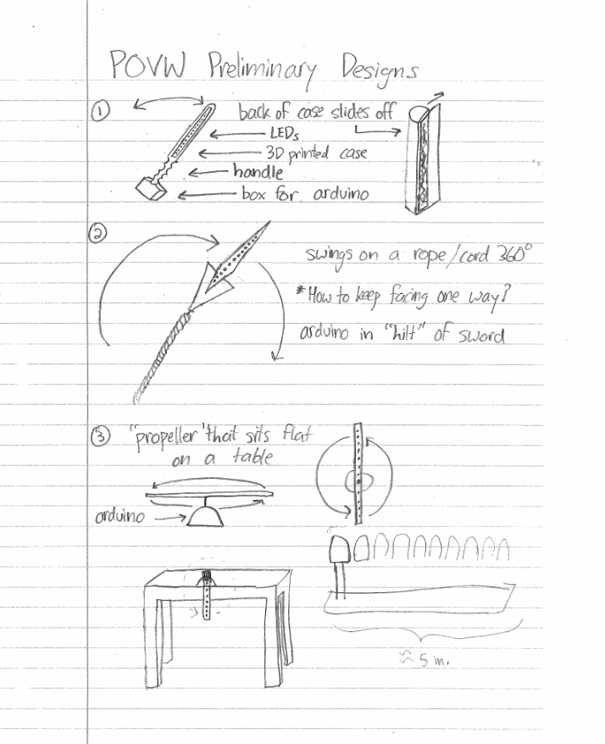
Alternative Design
Rotating design
Manual spin
Motor
Gyroscope
Bluetooth - to change message
Notes:
Collin

Slide 5
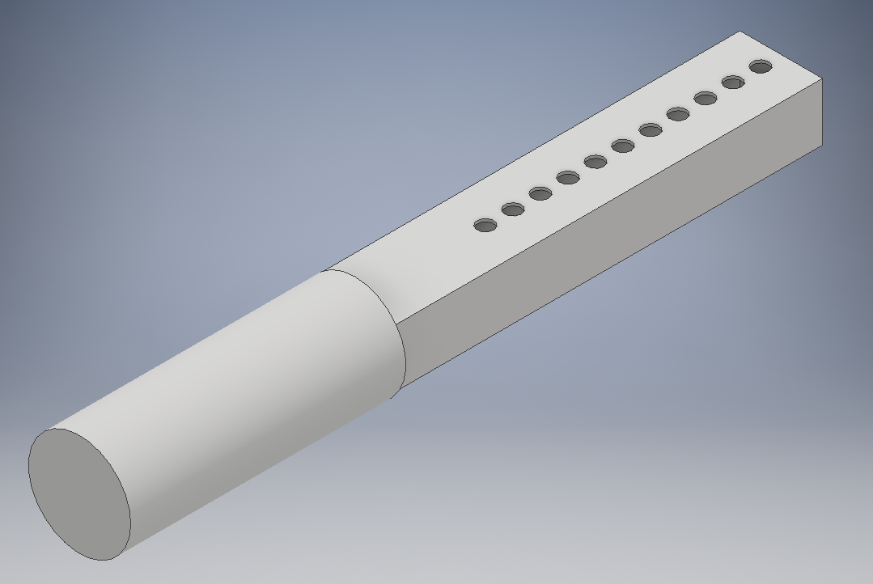
Aron’s Design
Notes:
Aron

Slide 6
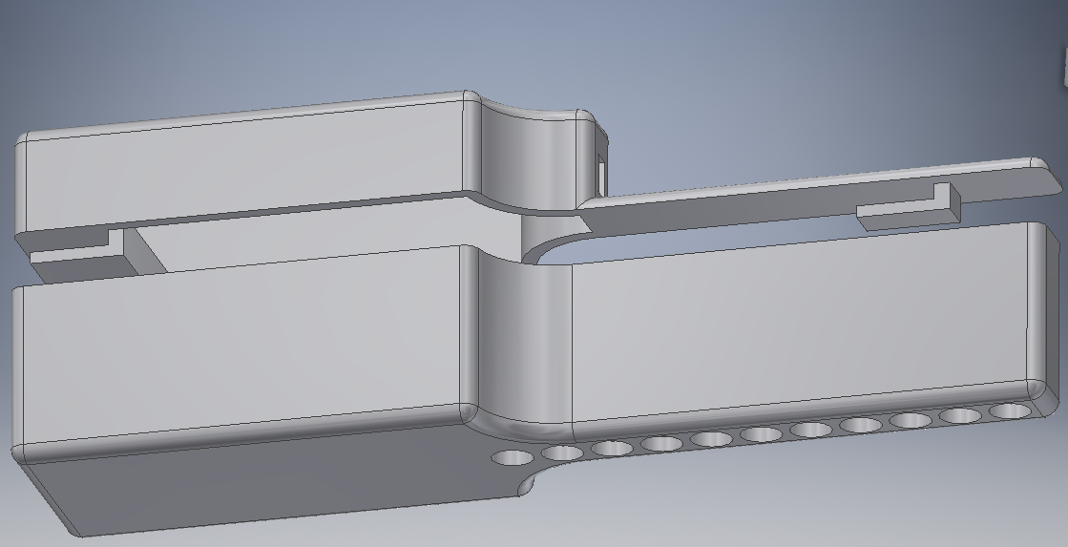
Ben’s Design
Notes:
Ben

Slide 7
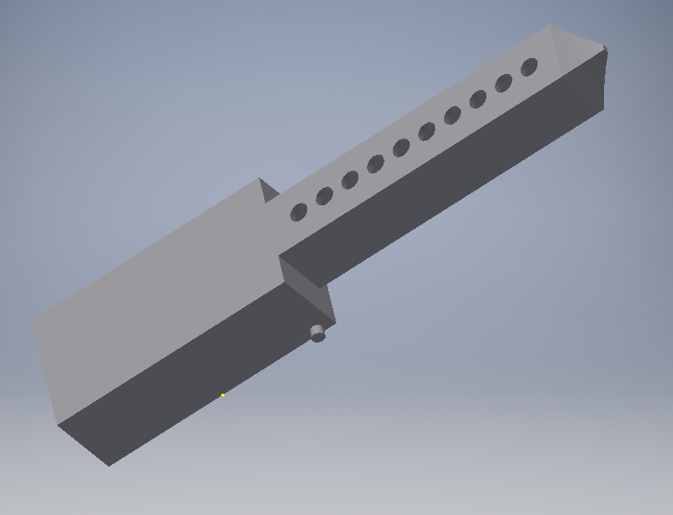
Collin’s Design
Notes:
Collin

Slide 8
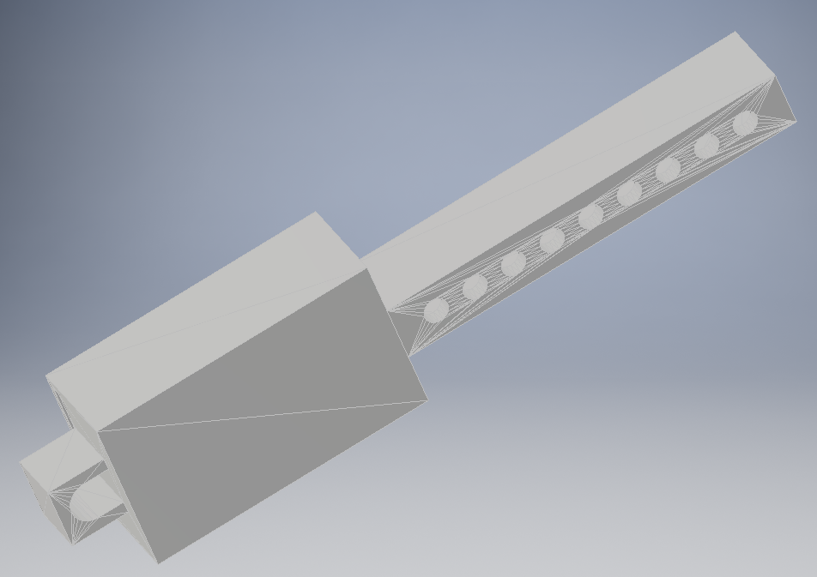
Dan’s Design
Notes:
Dan

Slide 9
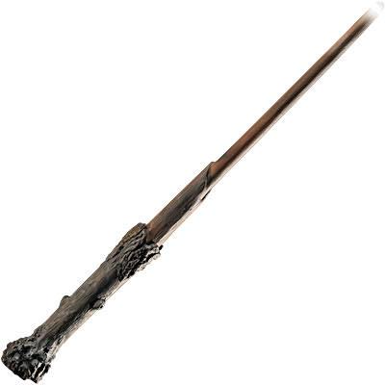
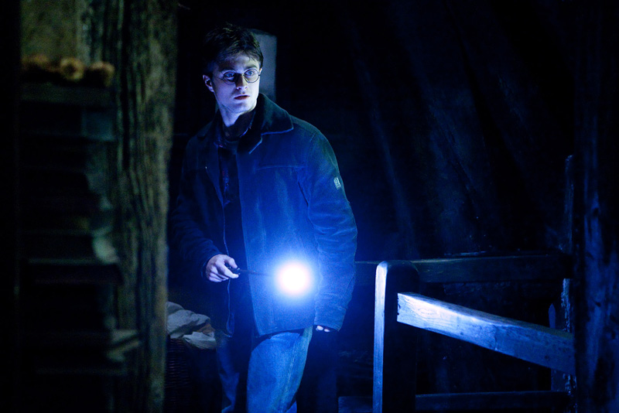
Harry’s Design
http://ryan-rushing.com/
http://ii.wbshop.com/
Notes:
Skip past this slide really quickly

Slide 10
Materials
Item Number | Item Name | Description | Seller | Unit Price | Units | Total Price
1 | ATtiny84 Chip | 14 pins, 8kb memory | Sparkfun | $2.95 | 4 | $11.80
2 | 14 pin socket | ATtiny84 fits inside | Sparkfun | $0.50 | 4 | $2.00
3 | 330 Ohm Resistors | 20 pack | Sparkfun | $0.95 | 3 | $2.85
4 | Super Bright LEDs | 100 pack (yellow) | Sparkfun | $19.95 | 1 | $19.95
5 | 9V Battery | Just a standard battery | Sparkfun | $1.95 | 4 | $7.80
6 | Black hook-up wire | 25' of wire | Sparkfun | $2.95 | 1 | $2.95
7 | Voltage regulator | 3.3V | Sparkfun | $1.95 | 4 | $7.80
8 | 9V Snap Connector | For connecting battery | Sparkfun | $1.25 | 4 | $5.00
10 | Power switch | For turning on and off | Sparkfun | $1.35 | 4 | $5.40
 |  |  |  | Total: | Price of plastic + | $65.55
Notes:
Aron, ~1-2 in^3 plastic per person, comes to ~$105

Slide 11
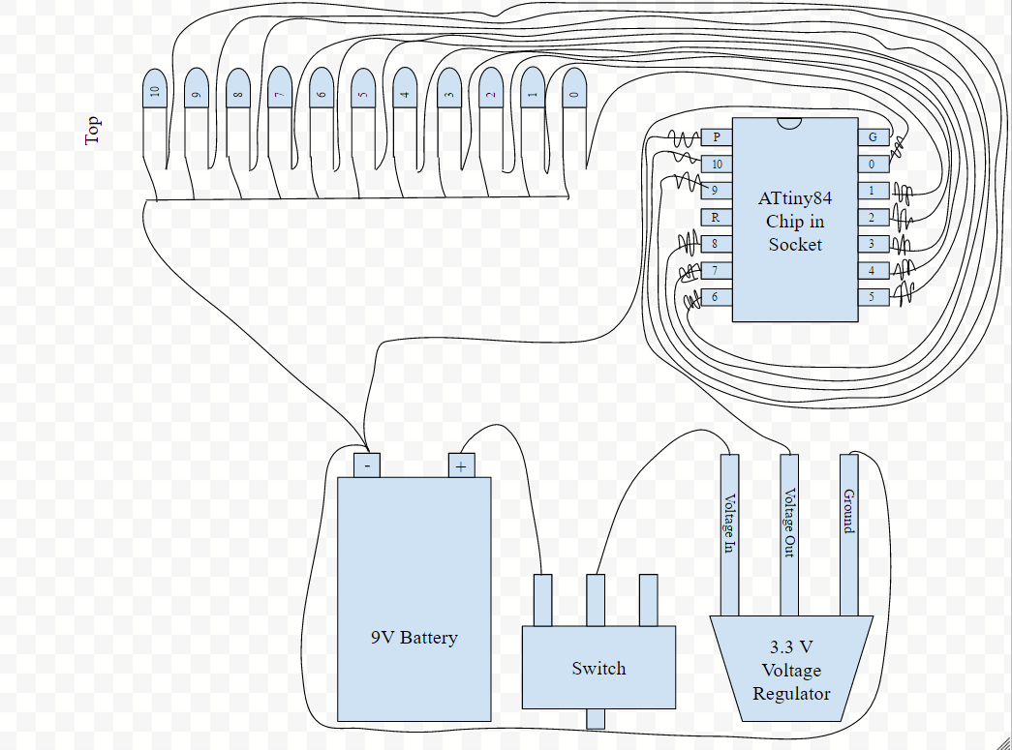
Circuits
9V battery
SPDT mini power switch
Voltage regulator - 9V to 3.3V
14 pin ATtiny84 chip
Super Bright LEDs (9,10, or 11) and 330 ohm resistors
LED pin number misunderstandings
Notes:
Ben

Slide 12
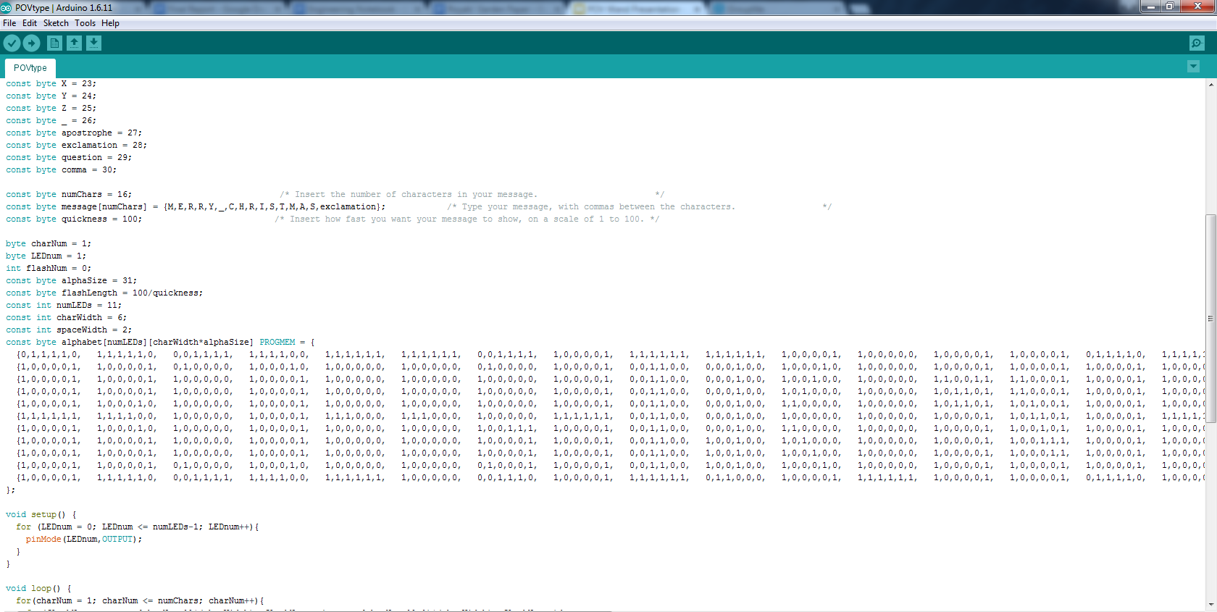
Program
Upload to the ATtiny84 chip
Used an array with 1’s and 0’s
Defined sections of the array as letters
When uploading message, you only type it
Notes:
Aron

Slide 13
Pseudo-code
A = 0;
B = 1;
message = {A,B,B,A}
alphabet = {
{0,1,1,1,1,0, 1,1,1,1,1,0, … },
{1,0,0,0,0,1, 1,0,0,0,0,1, … },
{1,0,0,0,0,1, 1,0,0,0,0,1, … },
{1,0,0,0,0,1, 1,0,0,0,0,1, … },
{1,0,0,0,0,1, 1,0,0,0,1,0, … },
{1,1,1,1,1,1, 1,1,1,1,0,0, … },
{1,0,0,0,0,1, 1,0,0,0,1,0, … },
{1,0,0,0,0,1, 1,0,0,0,0,1, … },
{1,0,0,0,0,1, 1,0,0,0,0,1, … },
{1,0,0,0,0,1, 1,0,0,0,0,1, … },
{1,0,0,0,0,1, 1,1,1,1,1,0, … }
}
for letter in message:
find letter in alphabet
for column in letter:
for number in column:
write number to LED
Notes:
Aron

Slide 14
Message
Aron - Hello, World!
Ben - Merry Christmas!
Collin - Pittsburgh Steelers!
Dan - Happy Holidays
Notes:
All of us - have audience guess

Slide 15
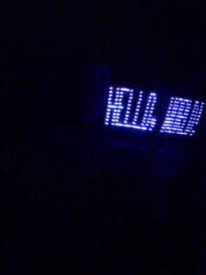
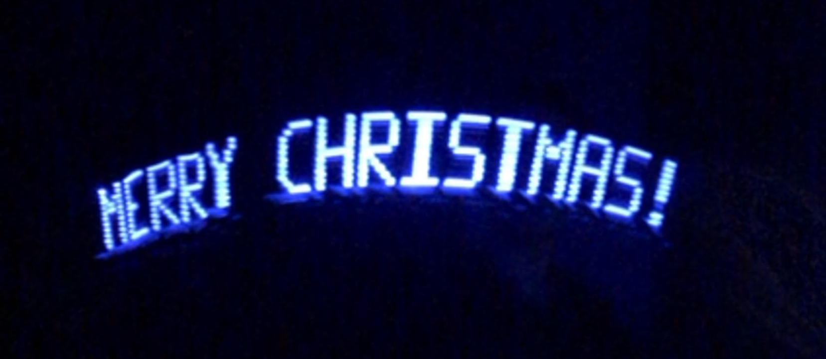
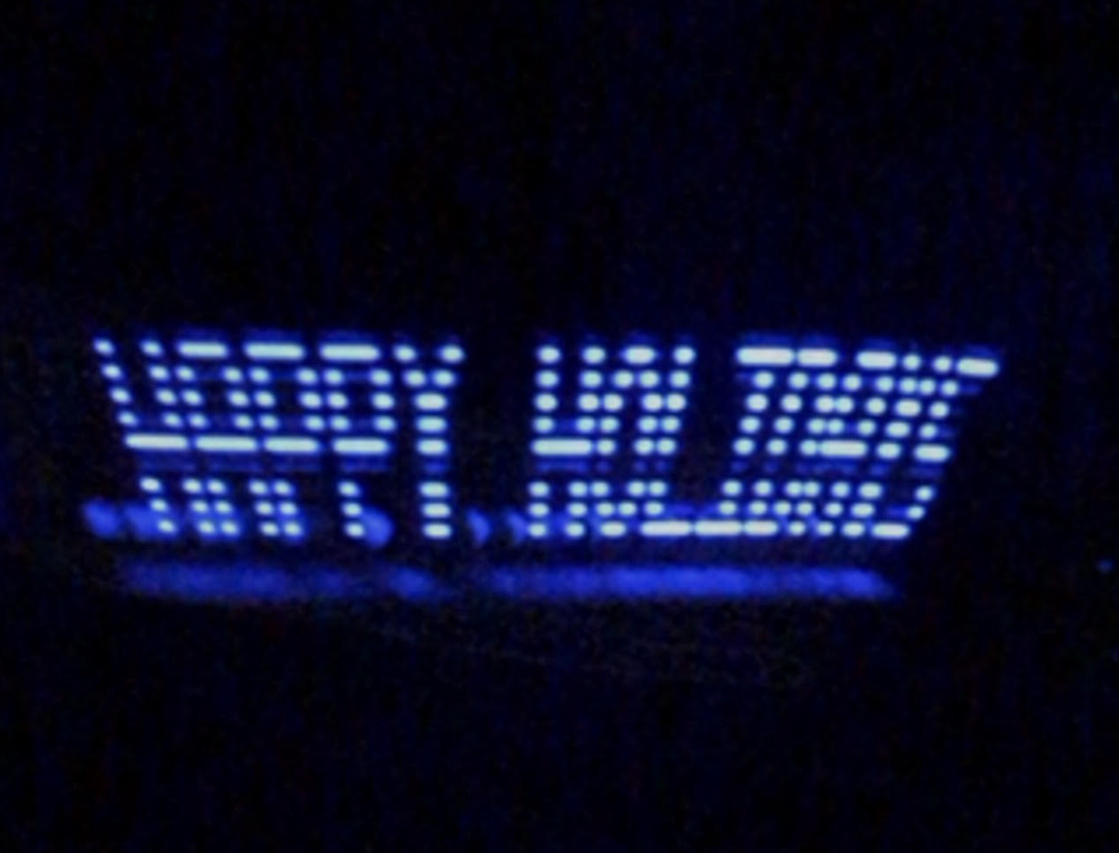
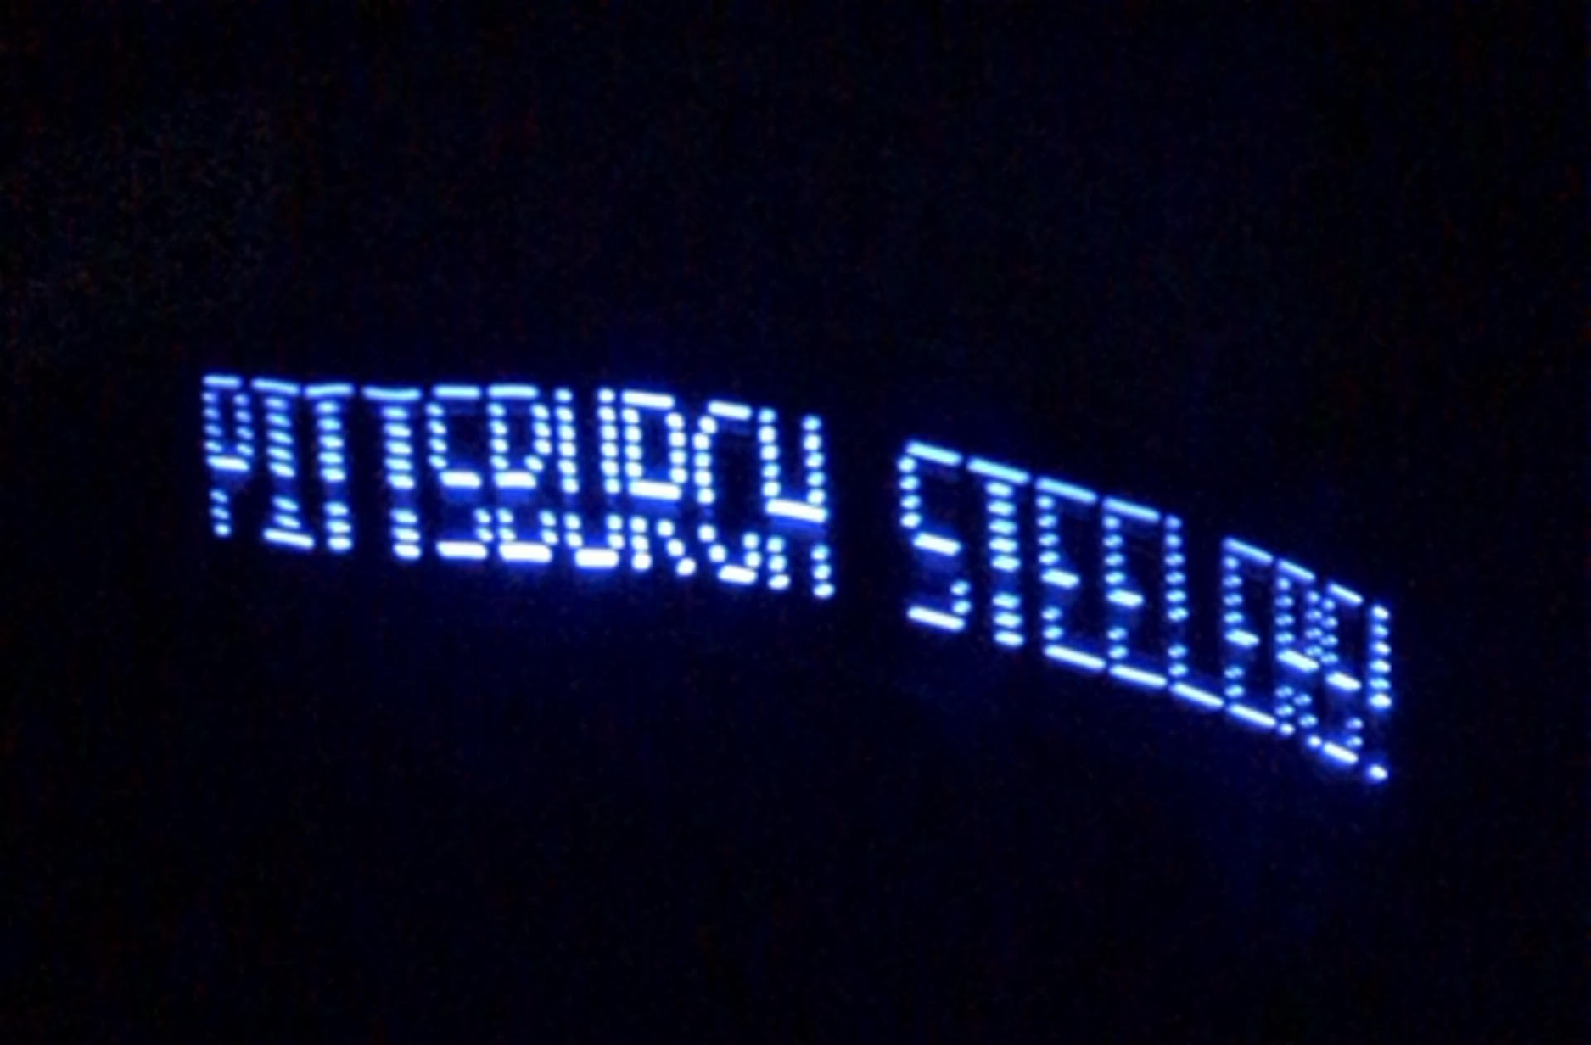
Photos
Notes:
Just show them

Slide 16
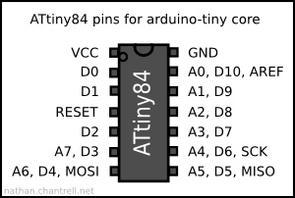
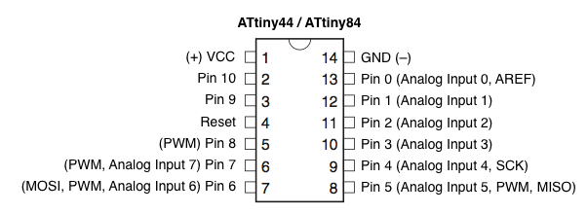
Small List of Challenges
Printer is stupid
Broken LEDs and/or Resistors and/or Wires and/or Pins and/or Collin
ATtiny84 pinout picture lied to us
Soldering iron + plastic = bad times
Fitting everything inside our cases
Ben burnt two of his LEDs
Cutting and burning ourselves
Aron broke his ATtiny84 chip
Forgetting to put on shrinkwrap before soldering
https://c2.staticflickr.com/
http://highlowtech.org/
Notes:
Collin

Slide 17
References
Anderson, B., & Anderson, J. (1993). The Myth of Persistence of Vision Revisited . Journal of
Film and Video, 45(1), 3-12. Retrieved from http://www.jstor.org/
B2ocled (n.d.). B2ocled 90mm USB-Powered Portable Fan with Clock, LED Light Display Time,
Mini Gooseneck Fan for laptop and PC-Green Light (Clock fan). Retrieved from the Amazon website: https://www.amazon.com/
Ghassaei, A. (n.d.). Persistence of Vision Wand. Retrieved from the Instructables website:
http://www.instructables.com/
Persistence of Vision (2016). In Oxford English Dictionary. Retrieved from http://www.oed.com/

Slide 18
How many times did you see the words “Merry Christmas?”
17Happy New Year!
Notes:
Dan

